Slide 1
Title : Sales Insights Unleashed:Revenue Trends with Data Analytics Name : Suriya Prakash S Roll no : RA2332241010337 Guide : Leena Nesamani S Institution : SRM Institute of Science and Technology

Slide 2
Sales Insights Unleashed:Revenue Trends with Data Analytics

Slide 3
ABSTRACT
This project focuses on analyzing sales data to uncover patterns, trends, and insights that can support strategic business decisions. By leveraging data visualization and statistical techniques, the analysis aims to identify top-performing products, seasonal trends, customer purchasing behavior, and sales performance across regions. The project uses tools like Excel, Python (Pandas, Numpy, Matplotlib, Seaborn), or Power BI to clean, process, and visualize the data.

Slide 4
METHODOLOGY
Data Collection : Tools – Kaggle
Data Loading and Inspection : Tools - Python Jupyter Notebook
Data Cleaning : Tools - Python, Pandas, NumPy.
Exploratory Data Analysis (EDA) : Tools - Python, Matplotlib, Seaborn.
Define Objectives and Problem Statements.
Predictive Analysis : Linear Regression
Visualization and Dashboard Creation : Tools – Power BI.

Slide 5
OBJECTIVE
Sales Performance Analysis – Evaluate overall sales trends, identify peak sales periods, and detect revenue patterns over time.
Customer Behavior Insights – Understand purchasing behavior, segment customers based on demographics, and analyze buying preferences.
Product Performance Assessment – Identify best-selling and underperforming products to optimize inventory and marketing efforts.
Data Visualization and Reporting – Present findings through interactive dashboards and reports using tools like Power BI, Python libraries.

Slide 6
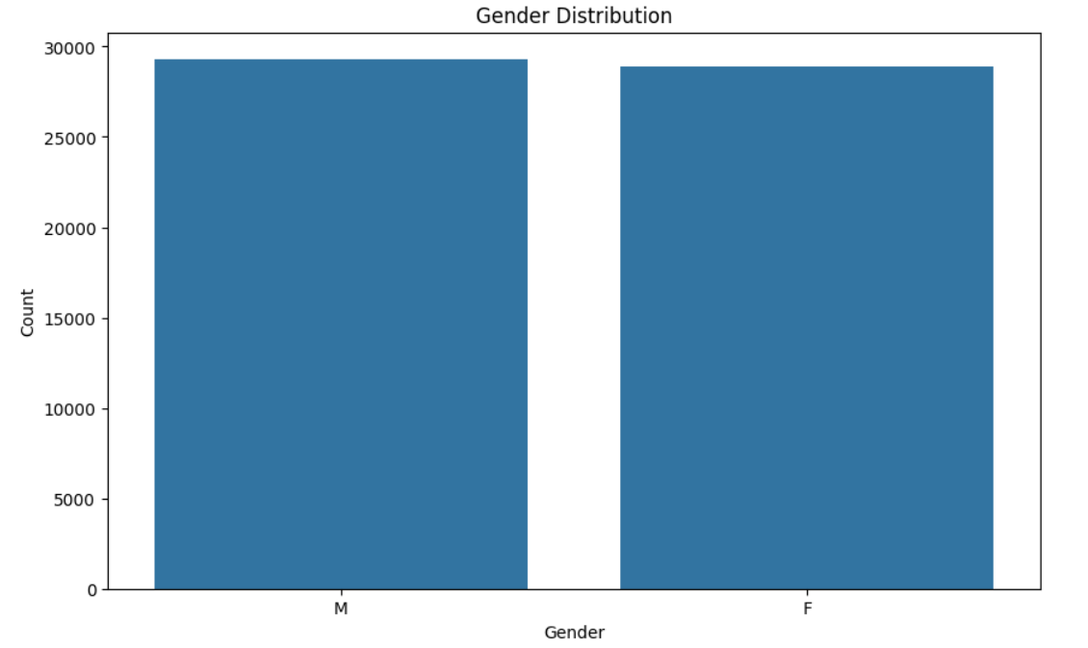
Gender Distribution

Slide 7
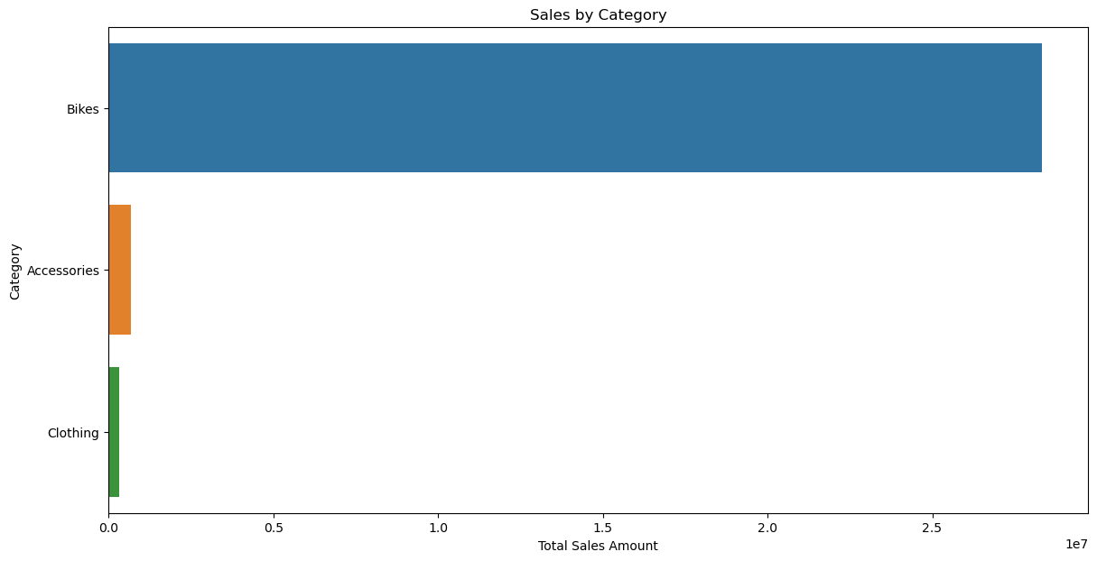
Sales by Category

Slide 8
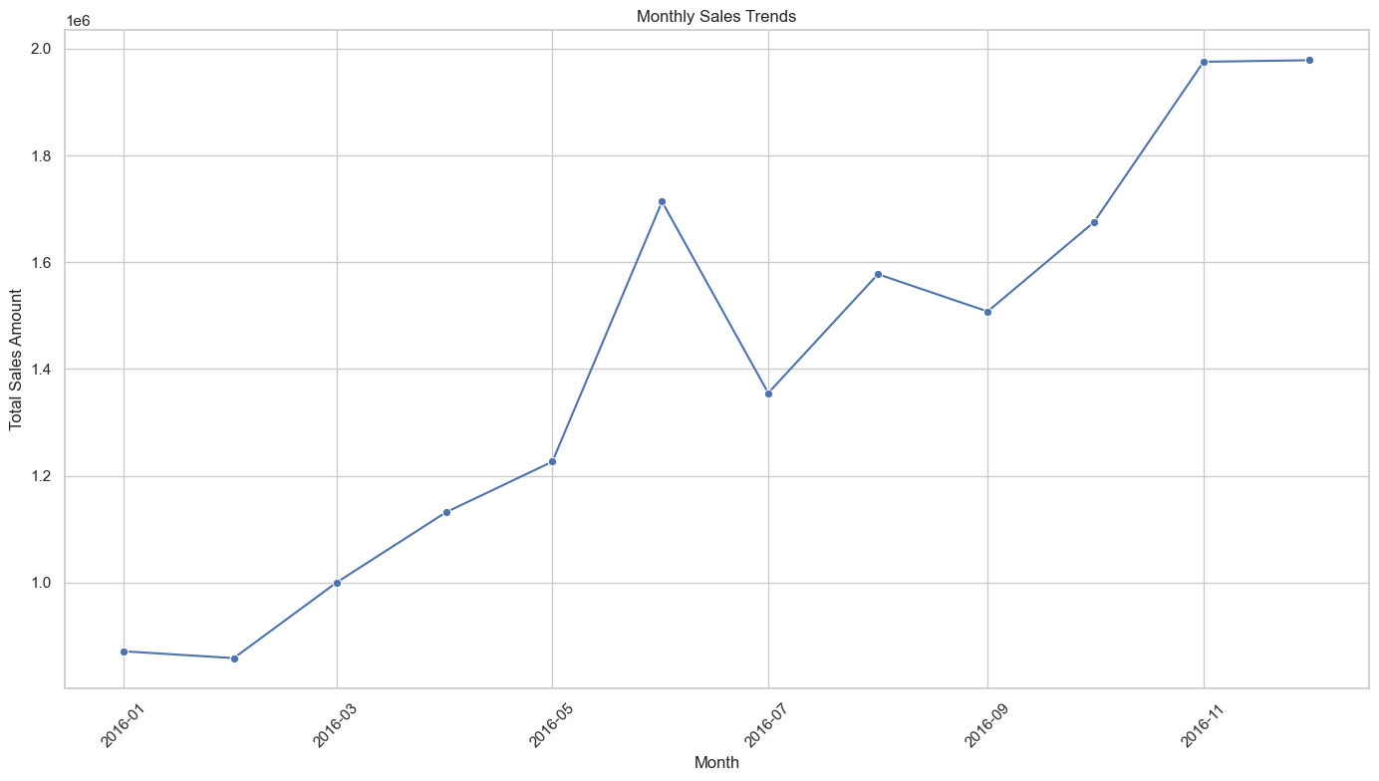
Visualize Monthly Contributions
The chart shows monthly sales trends for 2016:
Steady Increase: Sales generally increased throughout the year.
Peaks: Significant peaks in June and December.
Dips: Notable dips in February and July.
Overall, sales grew consistently with notable peaks mid-year and year-end.

Slide 9
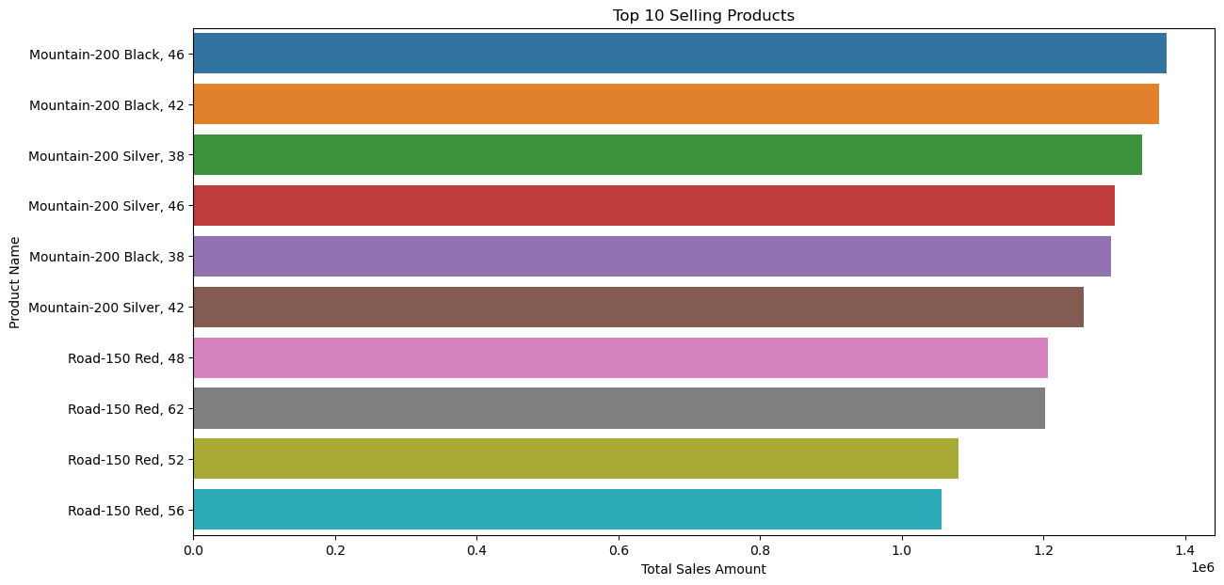
Identify Top-Selling Products

Slide 10
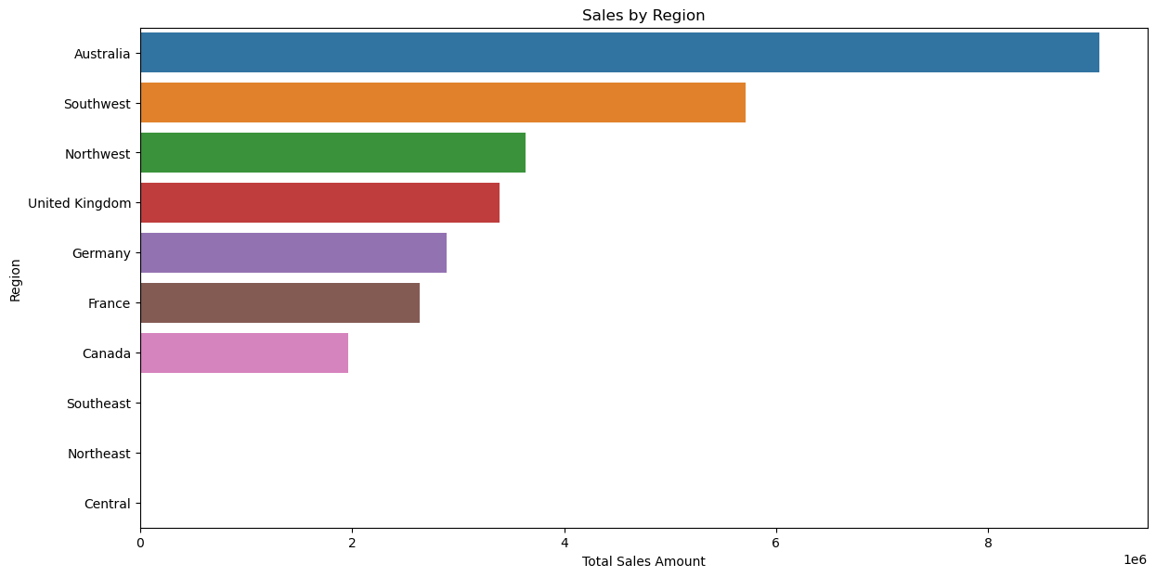
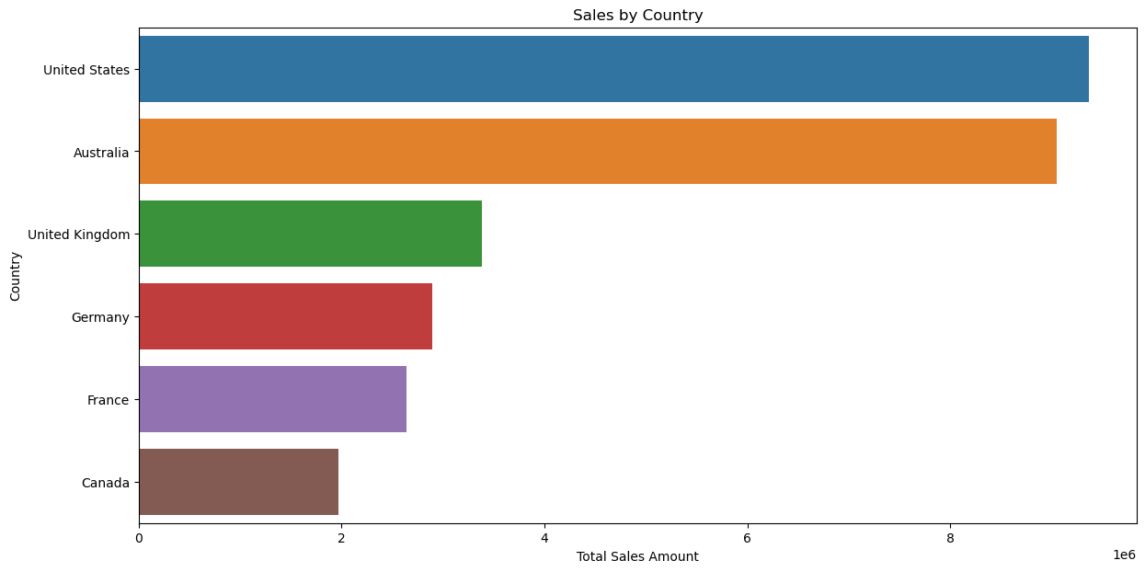
Market Analysis:
Analyzing Sales by Region, Country, and Sales Group

Slide 11
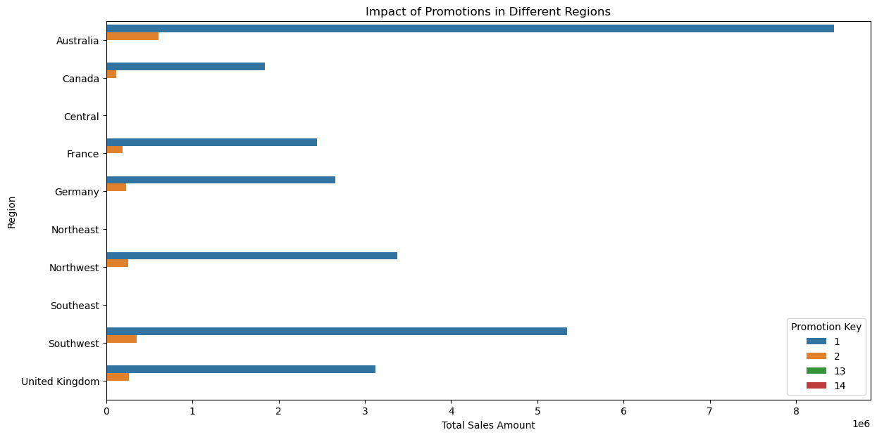
Studying the Impact of Regional Promotions

Slide 12
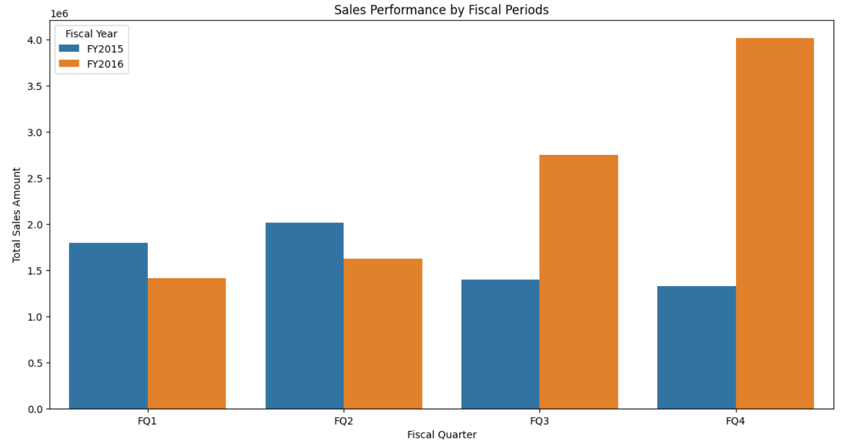
Analyzing Sales Performance by Fiscal Periods

Slide 13
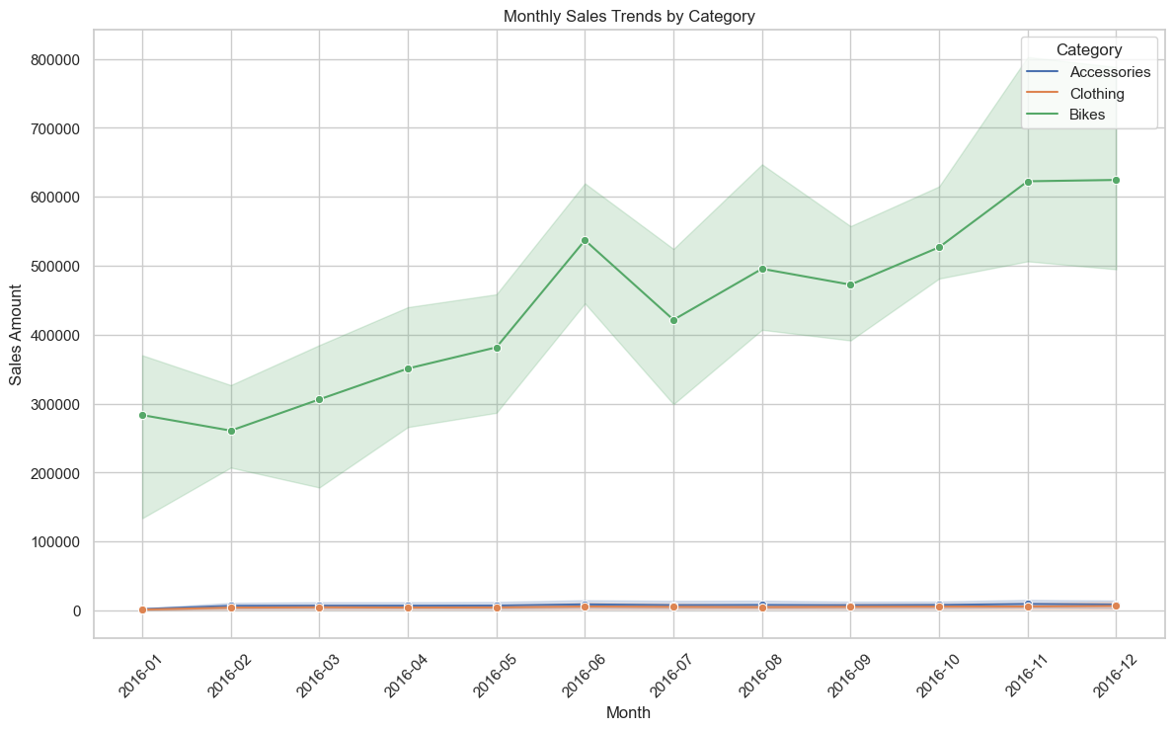
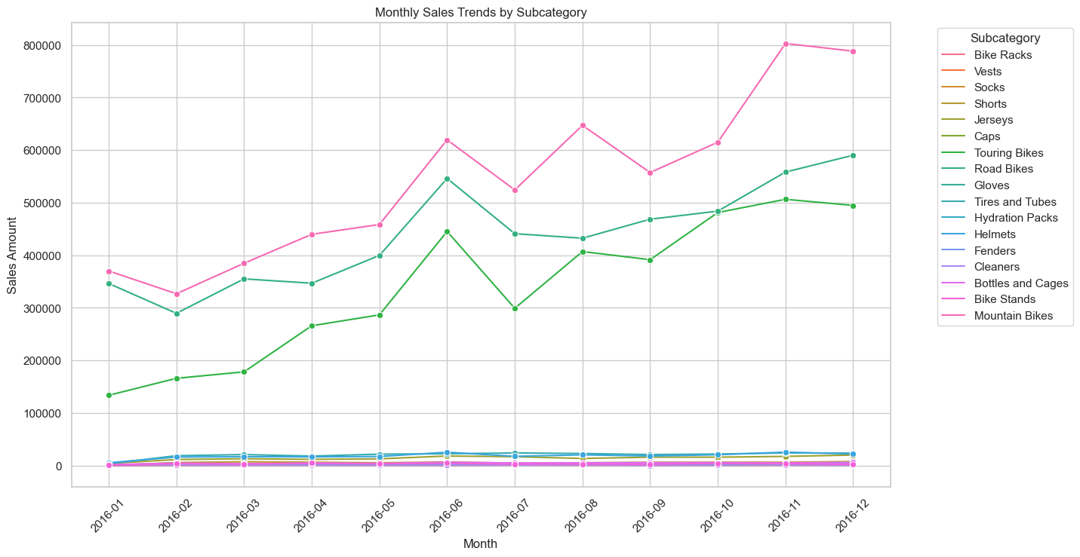
Identifying Seasonal Sales Trends Identify seasonal trends in sales across different product categories and subcategories to optimize inventory and marketing strategies.
Monthly Sales Trends:
- Bikes: Significant upward trend, peaking at 700,000.
- Accessories & Clothing: Flat, lower sales.
- Subcategories: Mountain and Road Bikes dominate with steady growth; other subcategories remain stable with low sales.

Slide 14
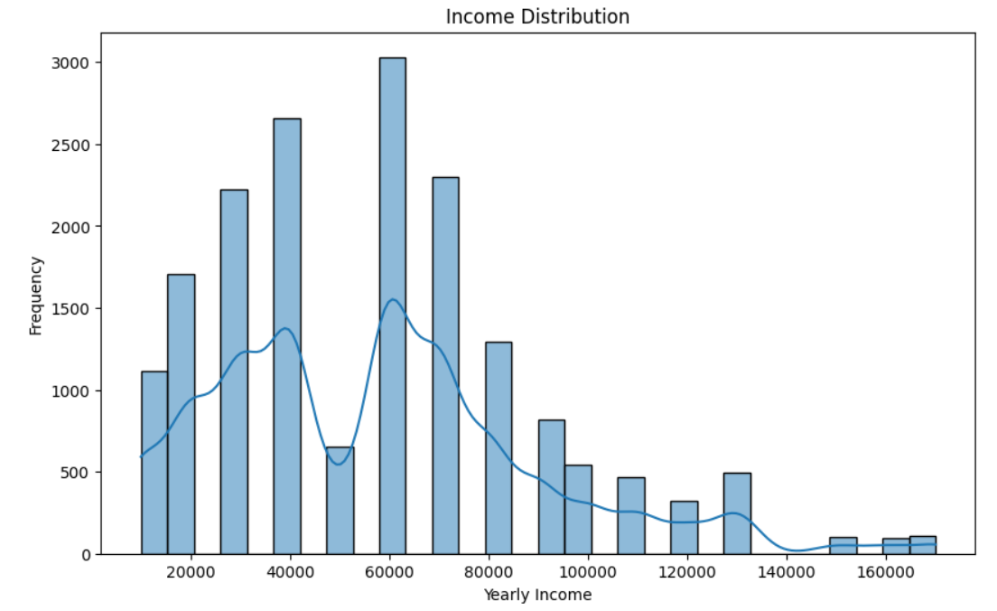
Income Distribution

Slide 15
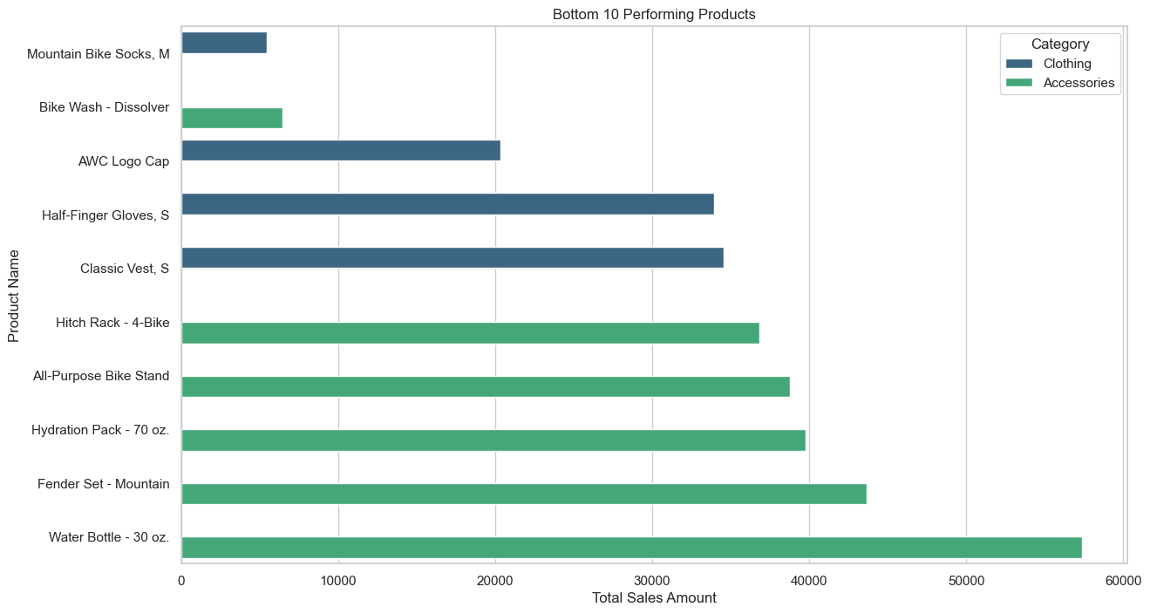

Slide 16
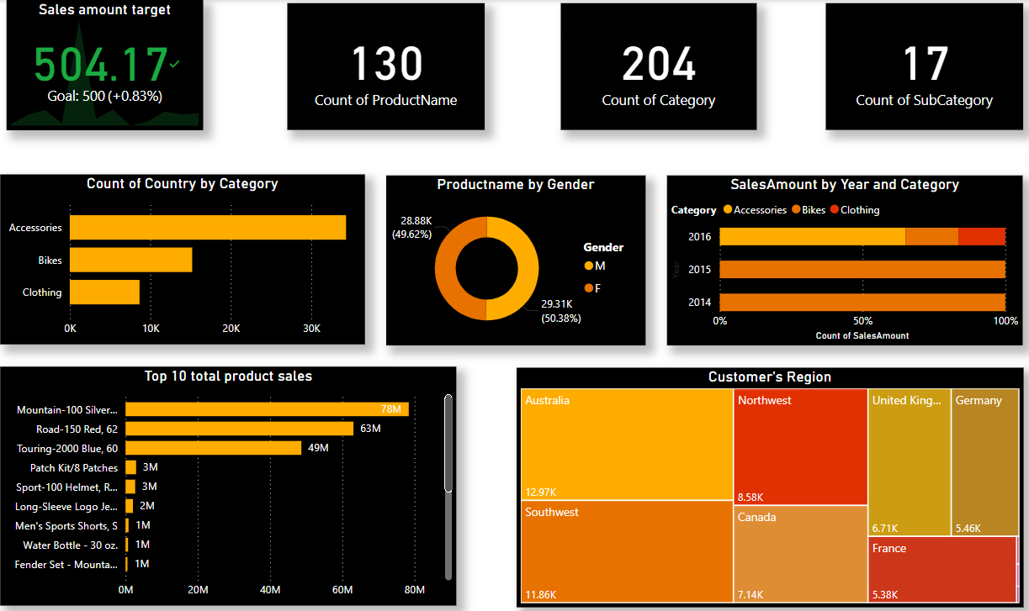
FINAL OUTPUT

Slide 17
CONCLUSION
Bikes: Show a significant upward sales trend, indicating strong and growing demand.
Accessories and Clothing: Exhibit relatively flat sales trends with lower sales amounts compared to Bikes.
Mountain and Road Bikes: Dominate sales with consistent growth, especially Mountain Bikes.
Other Subcategories: Remain stable with low sales across the months, without significant spikes or dips.

Slide 18
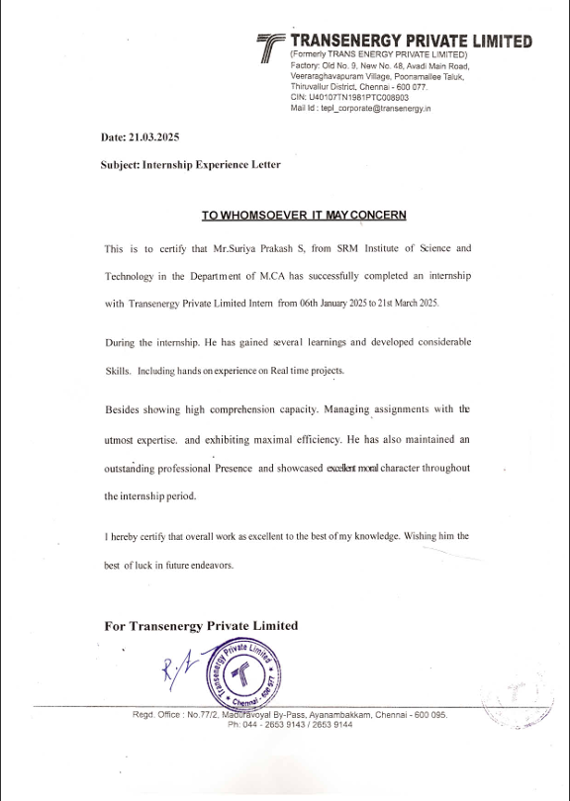
COMPANY LETTER

Slide 19
THANK YOU

